Slide 1
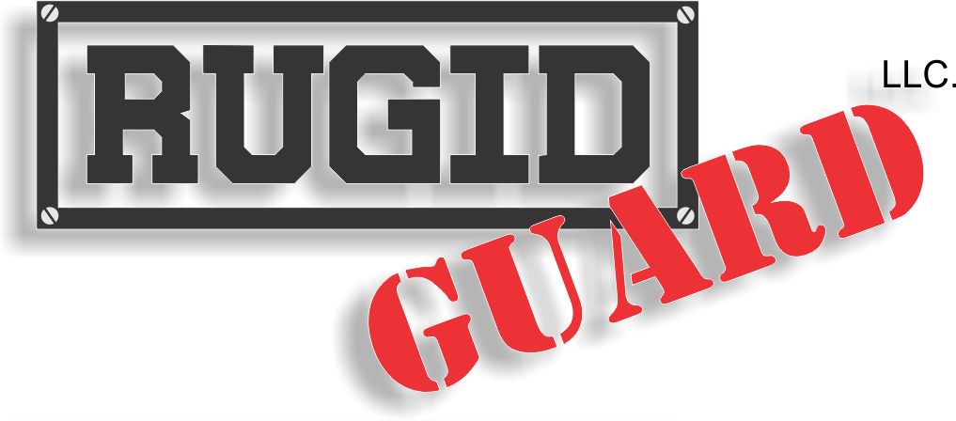
Specialized Coatings for Individualized Needs

Slide 2
The Rugid Guard System
We are the INDUSTRY LEADER
with over 1,300
Fueling Station INSTALLATIONS!
Rugid Guard, LLC has developed a protective process to refurbish your steel and concrete needs.
  Our fuel island repair process involves refurbishment to the metal curb and concrete. The entire island is sprayed with a high tensile strength industrial coating. Our specially formulated coating is designed to seal the surface and prevent further rust and corrosion.
  Rugid Guard protects your islands from petro-chemicals such as gasoline and oil. Our coatings are UV stable, impervious to salt and have a safe anti-skid surface for your customers.

Slide 3
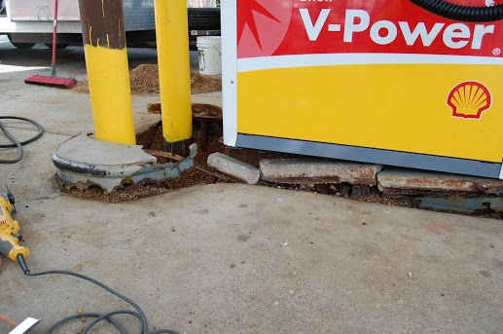
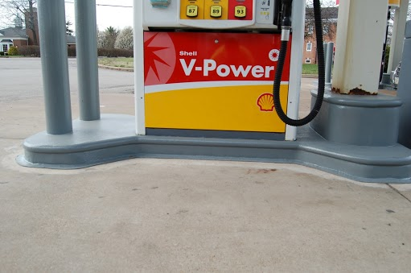
Petroleum Coatings
Before Rugid Guard
After Rugid Guard

Slide 4
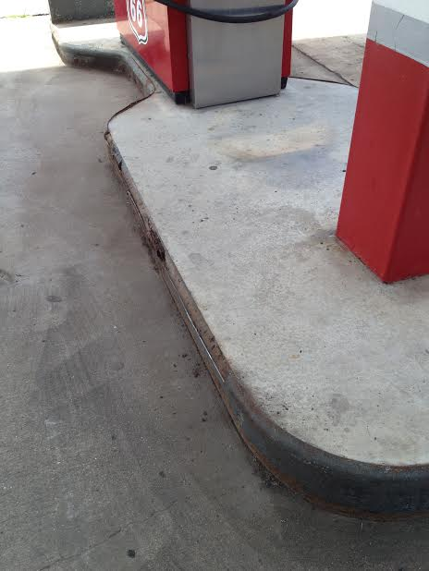
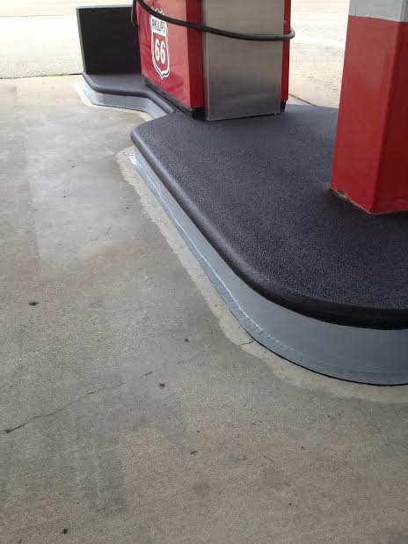
Custom Color Combinations
Phillips 66
Before Rugid Guard
Phillips 66
Silver & Gray

Slide 5
Protective Coating Applications
Gas and Diesel Islands
Sidewalk Curbing & Sidewalk Pad
Commercial Tankers
Fuel Tank Storage
Generator Tanks
Decorative Coatings
Waterproof Coatings

Slide 6
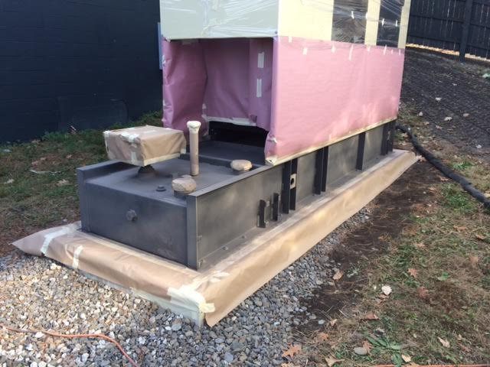
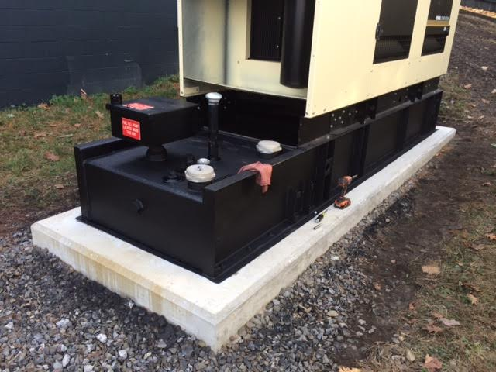
Generator Tank Coatings
Generator Pedestal Tank
Before Rugid Guard
After Rugid Guard Application

Slide 7
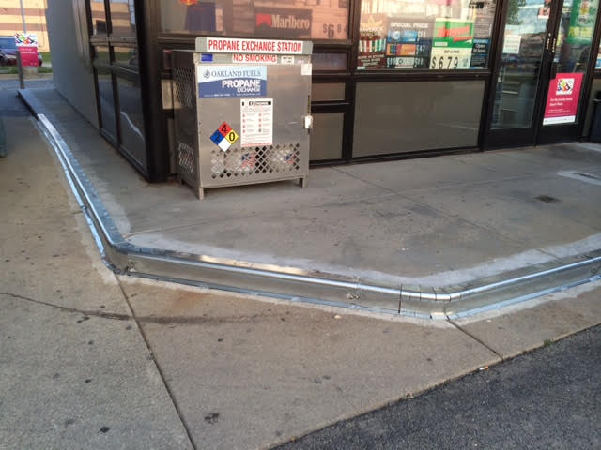
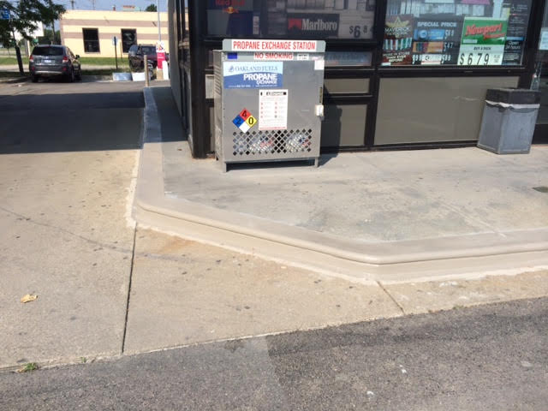
Sidewalk Curbing Repairs
We will replace metal as needed
Completed Sidewalk Curbing Repair

Slide 8
We know you your station is Important to you!
We create a cleaner and safer appearance for your customers
Islands are returned to service immediately upon completion
Easy to maintain – Simply power wash with mild degreasers
5 Year Warranty! Against warping, bubbling, color fade and
rust bleed-thru

Slide 9
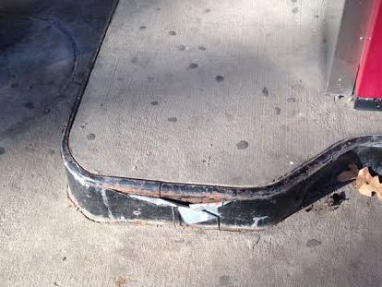
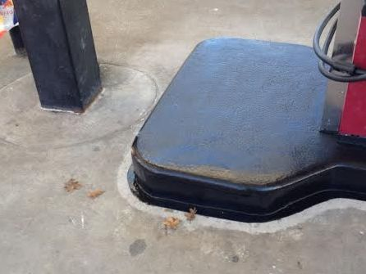
Dangerous Twisted Metal?
We Can Fix That!
Rugid Guard creates a safe, clean environment for your customer

Slide 10
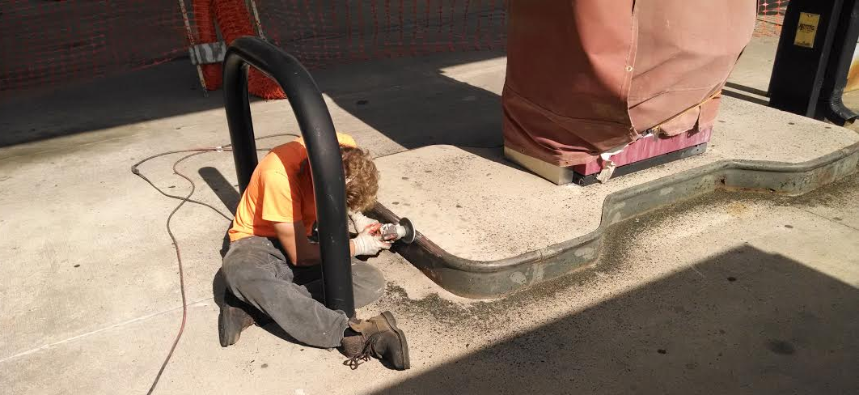
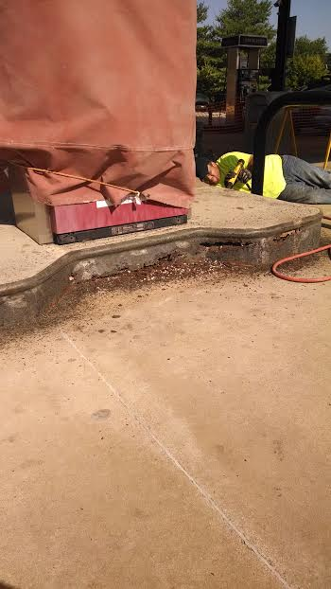
The Rugid Guard Process
Rugid Guard will remove
existing paint and rust.

Slide 11
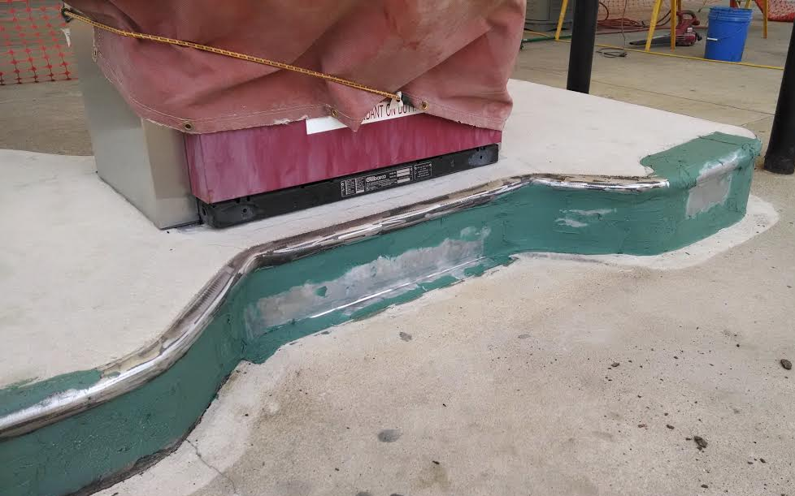
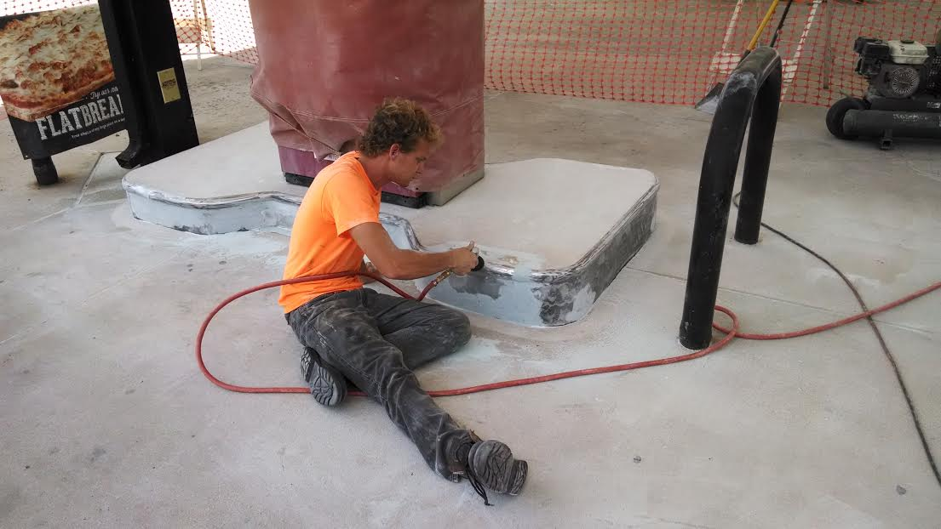
It’s All In The Prep
Replace metal and fiberglass as needed

Slide 12
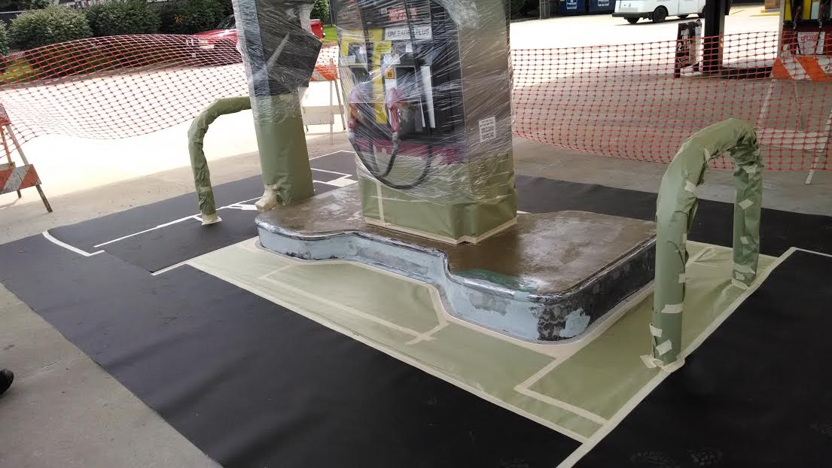
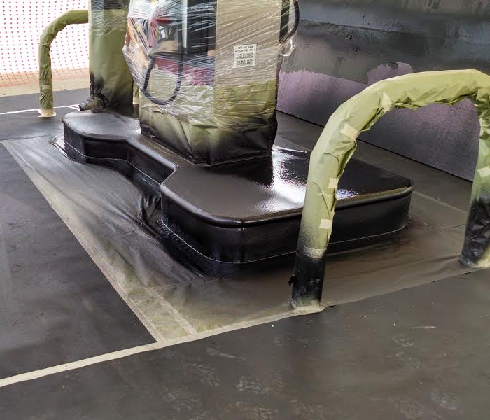
Primed and Ready to Spray!
We will protect the surrounding
surfaces prior to the spray application

